Slide 1

COMPANY PROFILE

Slide 2
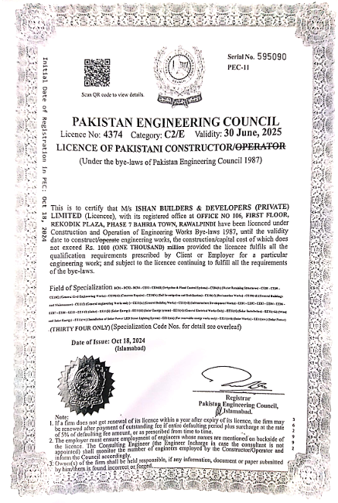
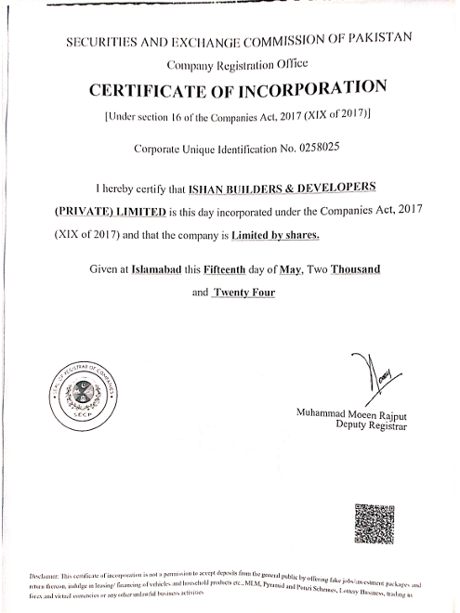
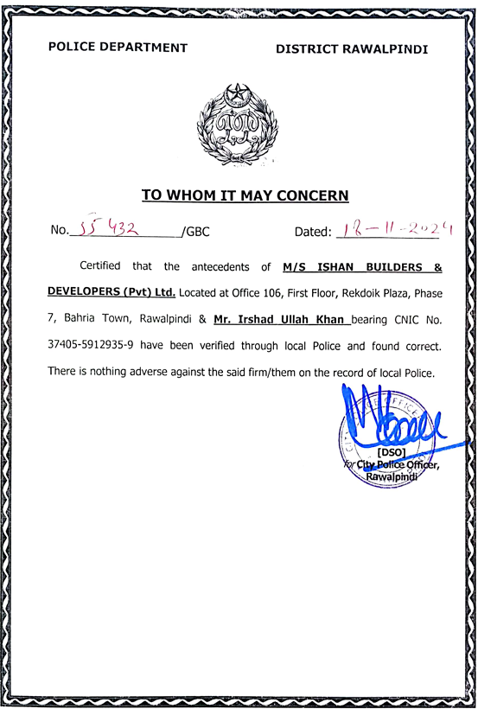
LEGAL FRAMEWORK

Slide 3
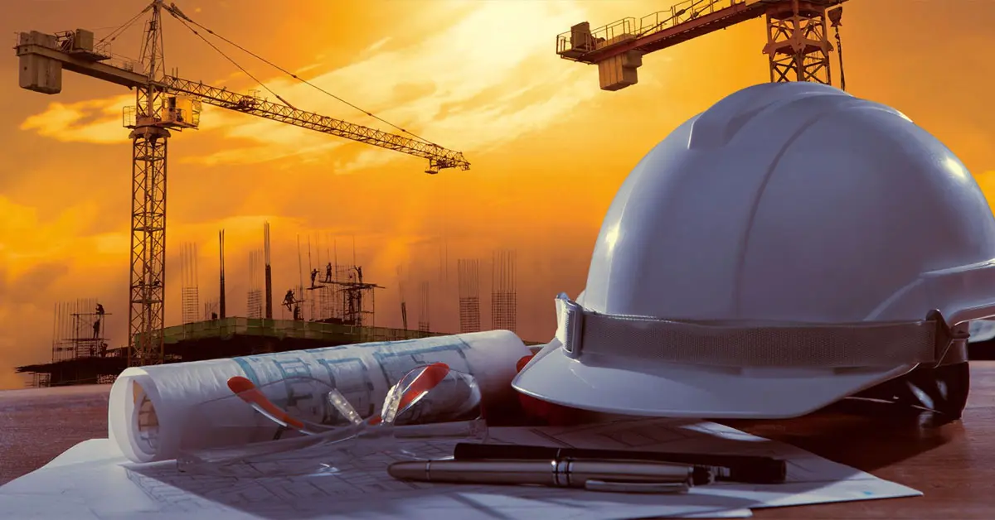
Ishan Builders & Developers(Pvt) Ltd is composition of team working since 2018. While having collaboration with different experts, each member possesses sound technical expertise which enabled to deliver the projects in time.
The company has various projects on its team’s credit, including isolated ventures and JVs.

Slide 4
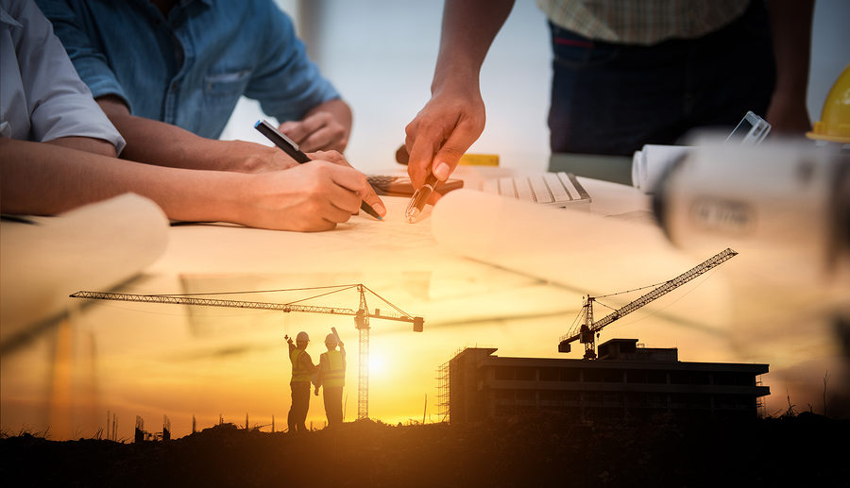
VISION OF THE COMPANY
We believe in “making the dreams come true”. Our vision is to create an environment of trust, loyalty and ownness by the client through delivering upto best of our capabilities. Concerted efforts with ultimate objective inclined towards customer’s satisfaction is our true achievement
MISSION STATEMENT
Deliver best quality services upto utmost satisfaction of user / client
Maintain high ethical and professional standards
Develop a culture of healthy competition and continuous improvement
Make use of technological advancements for comfort of end user
Make economical contributions to the community within reach of common user

Slide 5





OUR VLAUES YOUR TRUST
INTEGRITY
WE PROVE WHAT WE CLAIM
CREATIVITY
TRUTHFULNESS
WE ALWAYS THINK OUT OF THE BOX
WE BELIEVE IN TRANSPARENCY
CORE VALUES
EXCELLENCE
TEAM SPIRIT
WE BELIEVE IN DELIVERING THE BEST
WE PERFORM AS ONE TEAM
“We uphold the highest standards of honesty, transparency, and responsibility in everything we do, ensuring trust that stands the test of time”

Slide 6
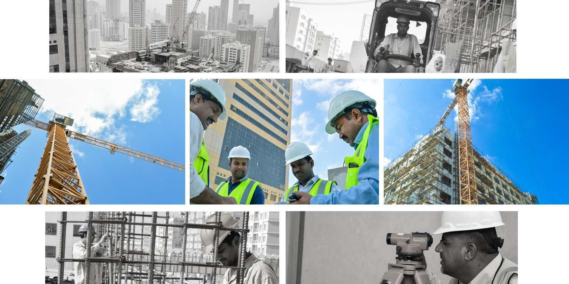
SERVICES
Construction, development, repair, maintenance, renovation and all kind of civil works etc
Pre-fabricated structures, their design and installations
Electrical services including house electrification, street lights etc.
Solarization projects
Design
Procurement
Logistic and supply chain
EXPERTISE
Buildings
Apartments
Hospitals constructions
Roads
Electrifications of all kinds
Solarization
HVAC services
Army Installations
High Rise Multi-purpose buildings
Repair,
Renovation and Maintenance projects

Slide 7
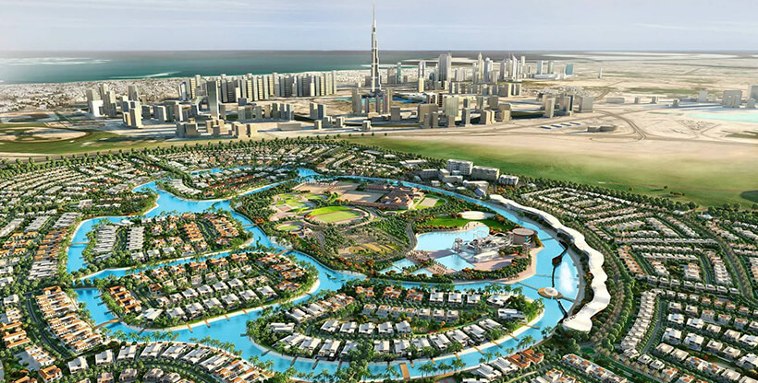
COMPLETED MEGA PROJECTS
PROJECT TITLE | LOCATION | PROJECT COST (PKR)
Montana Lodges | Murree Expressway | 300 Million
Insellberg Lodges | Skardu | 200 Million
Capital Tower | Phase VIII, Bahria Town, Rawalpindi | 500 Million
Capital Heights | Bahria Town, Karachi | 500 Million
Liberty Trade Centre | Bahria Town, Karachi | 400 Million

Slide 8
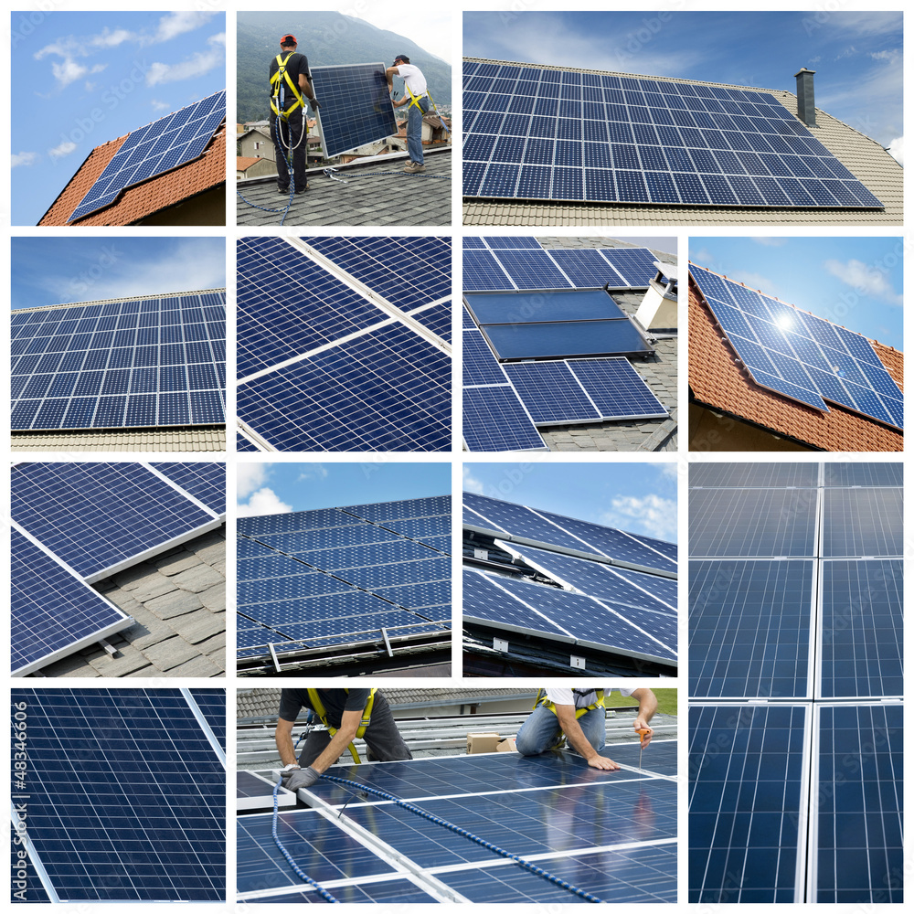
SOLARIZATION PROJECTS
SR. NO. | SOLAR SYSTEM | LOCATION
1 | 30 KW | Regional Workshop, Gujranwala
2 | 50 KW | ASC School, Nowshera
3 | 50Kw | Paradise Valley, Faisalabad
4 | 30KW | Faisal Garden , Faisalabad
5 | 20KW | Hashim Town, Peshawar
6 | 50KW | Khan Farms, Faisalabad
7 | 20KW | Sitara Villas, Faisalabad
8 | 30KW | Azhar Town, Jaranwala
9 | 15KW | Attock petroleum, Okara
10 | 10KW | Solar Tube Well Pakpatan
11 | 15KW | Solar Tube Well Head Balloki
12 | 10KW | 40 Homes Islamabad
13 | 10KW | 30 Homes, Islamabad
14 | 10KW | 25 Homes, Lahore
15 | 15KW | D.I Khan

Slide 9
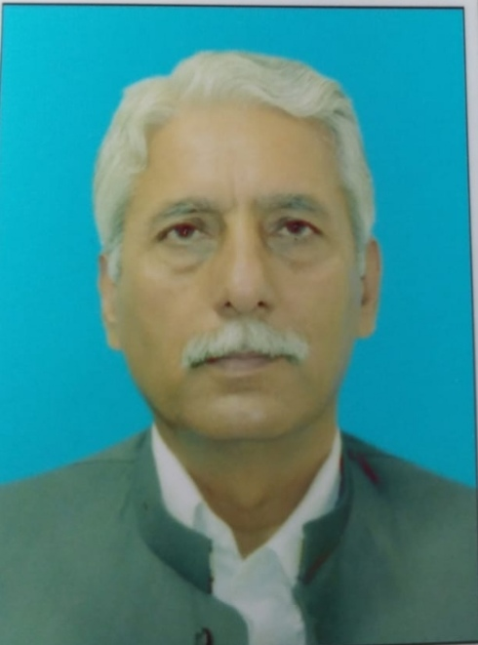
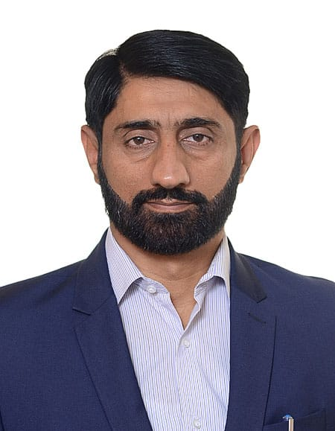
CORE TEAM
MAJOR ALAMGEER KHAN (Retd.)
LT COL IRSHAD ULLAH KHAN (Retd.)
CHAIRMAN
Chief Executive Officer
+92 301 1018921
Alamgeerk@hotmail.com
+92 327 9908321
Irshad_34405@yahoo.com
40+ Years of Experience in Public & Private Sector for management, administration, idea and conceptualization of projects of public and national interest
25+ Years of Experience in Public & Private Sector for project management, planning, execution and aftercare services related to engineering, development and infrastructure
PROJECT MANAGEMENT
95%
PROJECT MANAGEMENT
99%
FINANCIAL MANAGEMENT
80%
PROJECT EXECUTION
90%
CORPORATE GOVERNANCE
70%
INFRASTRUCTURE DEVELOPMENT
75%
NAME | DESIGNATION
Anwar Baig, A. Engg. | Director
Tariq Masood, M.A | HR Manager
Zain Tariq, B.E (Civil Engineering) | Project Manager
Ahmad Anwar B. E ( Software Engineering) | Site Engineer
Muhammad Iftikhar, B.A | Supervisor

Slide 10
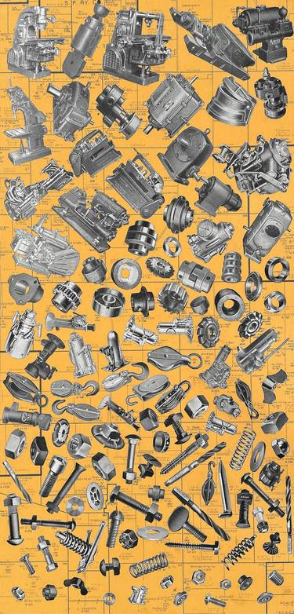
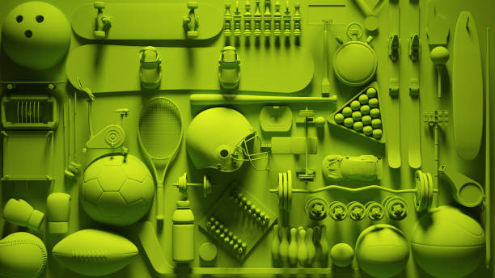
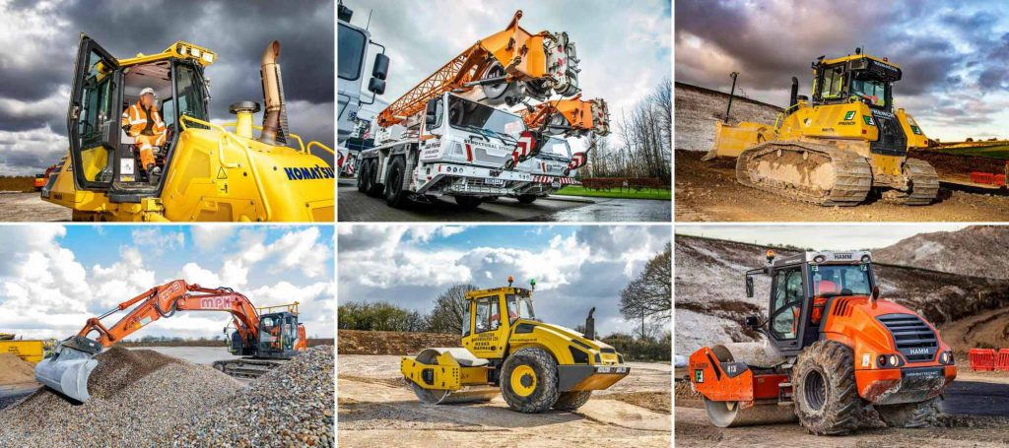
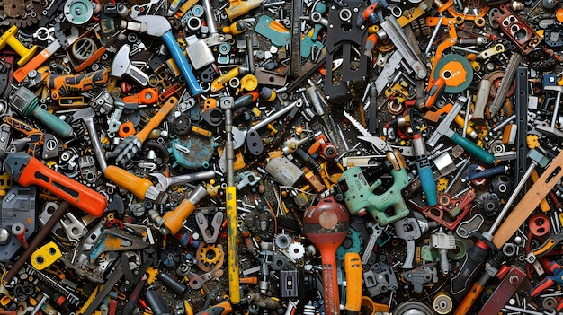
MACHINERY
SR | Description | Unit | Qty | Qty
1 | Mixer Machine | No | 2 | 2
2 | Vibrator | No | 1 | 1
3 | Plate Compactor | No | 1 | 1
4 | Water Pumps | No | 2 | 2
5 | Donkey Pump with Motor Peter Engine | No | 2 | 2
6 | Steel Shuttering Plates | Sft | 10000 | 10000
7 | Scaffolding operated hoist to lift material | Set | 1 | 1
8 | Dewatering Pump | No | 2 | 2
9 | Grinding Machine | No | 1 | 1
10 | Wheel Barrow | No | 10 | 10
11 | Level Machine | No | 1 | 1
12 | Wooden Planks | No | 70 | 70
13 | Scaffolder Steel Tubular Pipes with necessary joints | No | 1000 | 1000
Transport
14 | Tractor with trolley and blade etc | No | 1
15 | Motor Car | No | 2
16 | Pick Up (Suzuki Ravi) | No | 1
17 | Motorcycle | No | 2

